Slide 1


Detection of miscellaneous defects using segmentation
by
Team segmentation - Team 2
David Rodríguez
Enrique Hernández
Víctor Maya
Hackathon

Slide 2
ABSTRACT
Anomaly detection is the task of detecting instances that deviate strongly from the norm.
With the machine learning that it is been developing with the years and all the data we are generating it’s becoming in a very interesting tool to solve problems.
Hackathon

Slide 3
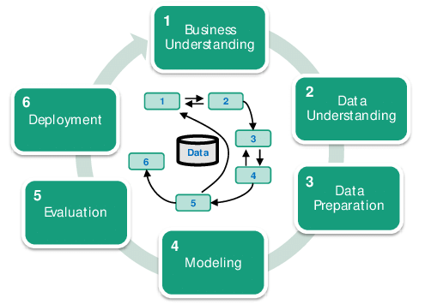
Methodology:
Cross industry for data mining
Materials:
Defect Recognition Challenge Kaggle data set
Google Coolab

Slide 4
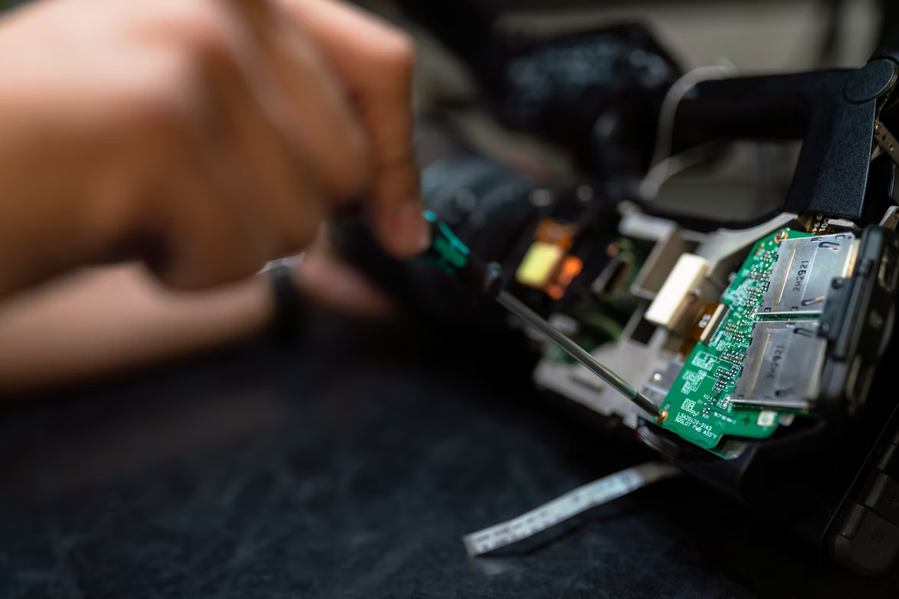
Why does it matter?
Anomalies can represent a huge cost for the industry:
Preventive maintenance represents about a 10-30% of the total cost of a corrective maintenance. (Stenström, 2015)

Slide 5
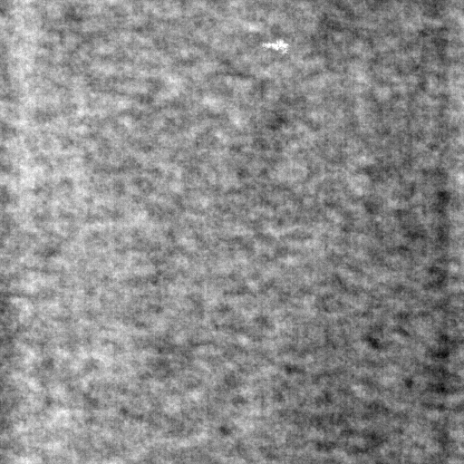
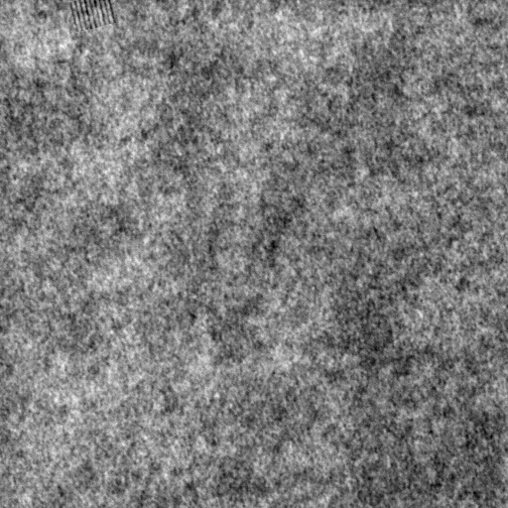
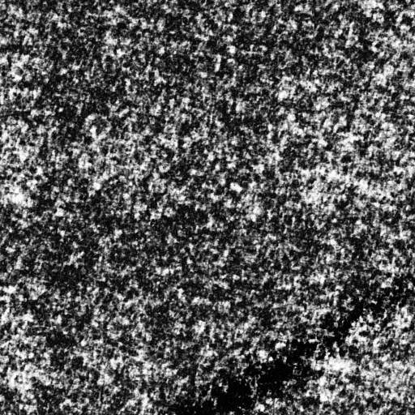
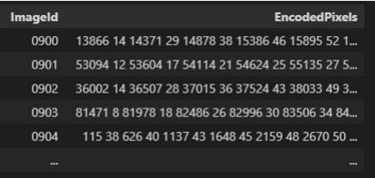
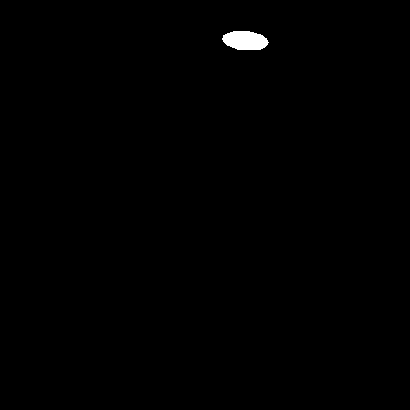


X
…
512 x 512
Model
y
CSV
…
512 x 512

Slide 6
Key questions to consider
How large is our dataset?
What’s the size of each picture?
What’s the distribution of color/intensity?
What’s the relation between the white and black zones in the mask?
What models for predictions are the best for this kind of data?
How do we need to process the data before passing it through the model?
How are the outputs?

Slide 7
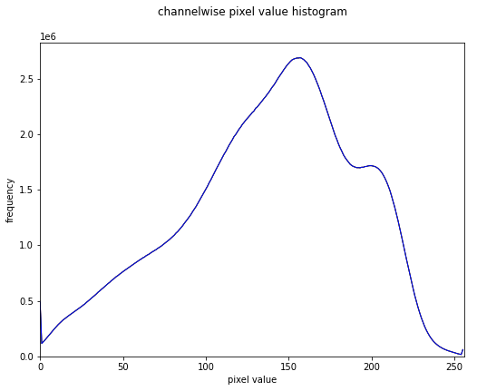
DEA train set (image)
Grays levels
mean | 137.39
min | 0
max | 255

Slide 8
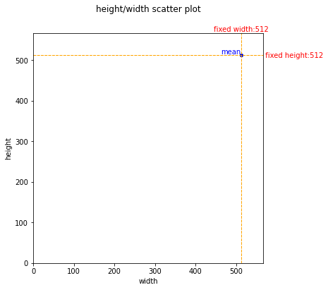
DEA train set (image)
size images
mean height/width ratio | 1
min height/width | 512/512
max height/width | 512/512

Slide 9
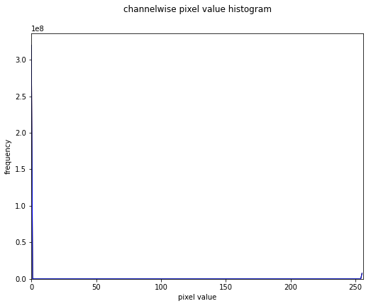
DEA train set (mask)
Grays levels
% 0 level gray pixel | 0.976
min | 0
max | 255

Slide 10
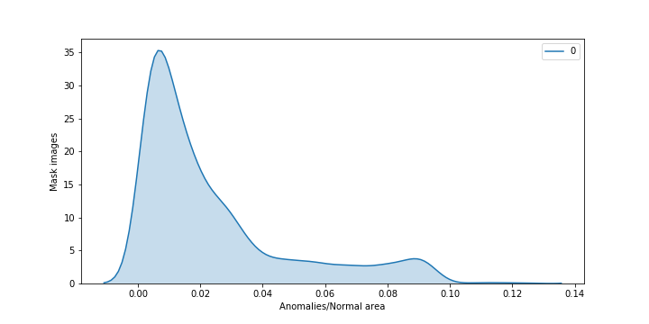
Is there a ration distribution for anomalies?

Slide 11
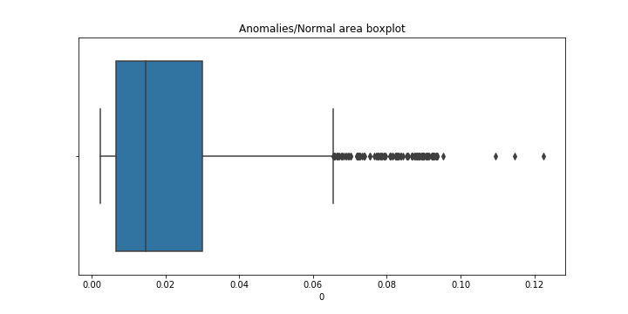
Anomalies/Normal area in mask boxplot

Slide 12
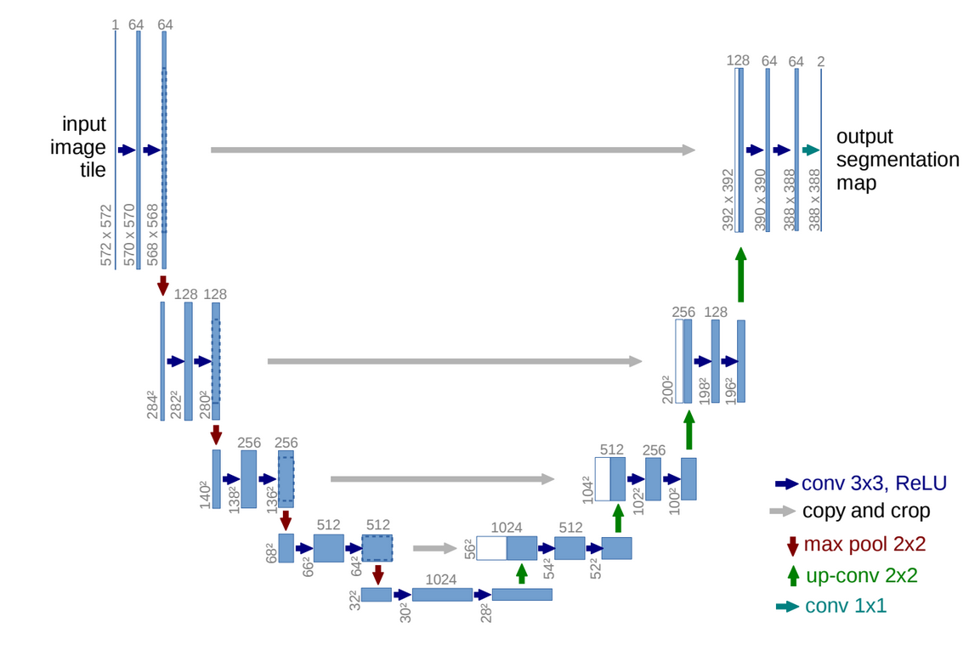
U-net architecture
It is presented by Olaf et al.
It consists of a contracting path to capture context and a symmetric expanding path.
Source: U-Net: Convolutional Networks for Biomedical Image Segmentation

Slide 13
References
Christer Stenström, Per Norrbin, Aditya Parida & Uday Kumar (2016) Preventive and corrective maintenance – cost comparison and cost–benefit analysis, Structure and Infrastructure Engineering, 12:5, 603-617, DOI: 10.1080/15732479.2015.1032983
https://towardsdatascience.com/understanding-semantic-segmentation-with-unet-6be4f42d4b47
https://www.kaggle.com/vbookshelf/simple-cell-segmentation-with-keras-and-u-net
https://www.kaggle.com/rakhlin/fast-run-length-encoding-python/script
https://developers.google.com/machine-learning/practica/image-classification/convolutional-neural-networks?hl=es_419
https://arxiv.org/pdf/2001.05566.pdf

